Slide 1


Single Center Experience with Drug Eluting Stents for Infrapopliteal Occlusive Disease in Patients with Critical Limb Ischemia: Mid-term follow up
Robert Lookstein MD FSIR
Chief, Interventional Radiology
Mount Sinai Medical Center
Notes:
Fischman, Aaron M.¹; Shah, Salman S.¹; Kim, Edward¹; Stangl, P. Anondo¹; Nowakowski, F. Scott¹; Weintraub, Joshua L.¹; Lookstein, Robert¹

Slide 2
Critical Limb Ischemia
Most severe form of Peripheral Arterial Disease (PAD).
Over 100,000 lower extremity amputations are performed in the United States (US) yearly for Critical Limb Ischemia.
In the United States, the amputation rate has increased from 19 30 per 100,000 persons years over the last two decades primarily due to an increase in diabetes and advancing age.
The prognosis for patients with critical limb ischemia is poor
  25% mortality rate in first year
    (less than the survival rate of breast & colon cancers)
  25% amputation rate in first year
  50% of all below the knee amputation patients do not survive beyond 5 years

Slide 3
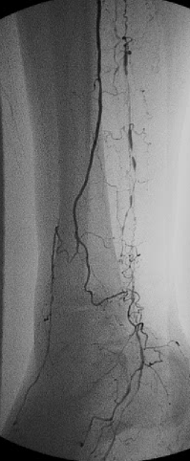
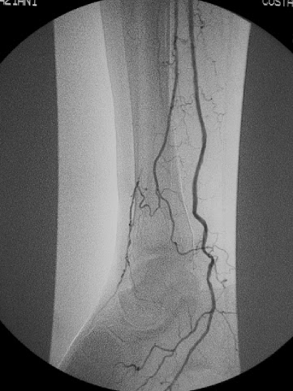
Management of Critical Limb Ischemia
Goals –
Restore adequate perfusion to the affected limb
Reduce or eliminate ischemic pain
Achieve wound healing / salvage limb
Critical Limb Ischemia is associated with extensive atherosclerosis of the infrapopliteal or “below knee” arteries
Gold Standard is Surgical Bypass
Many patients cannot be offered bypass surgery
Severe medical comorbidity (cardiac, pulmonary)
Inadequate vein to perform the bypass
Endovascular Therapy
Increasingly being used to treat CLI
Ideal for patients without conduit, severe medical comorbidities
Traditional therapy has been balloon angioplasty
with reported patency rates of 50% at one year in the below knee circulation

Slide 4
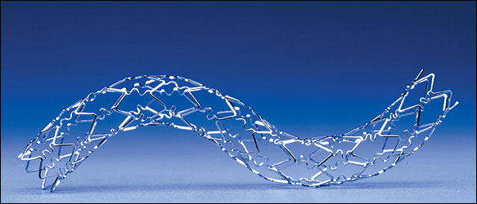
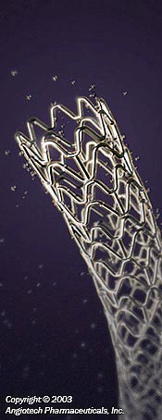
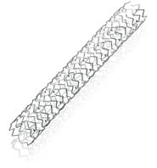
Objective
Drug-eluting stents (DES) have been shown to be effective in the treatment of coronary artery disease
This study reports a single center experience in the use of this technology in the treatment of below knee arterial disease in the setting of critical limb ischemia

Slide 5
Materials and Methods
October 2005 to October 2012
107 patients 66 male ,41 female
  mean age 82, range 43-93
  All patients had symptoms of critical limb ischemia at presentation prior to treatment
  All patients were considered poor surgical candidates due to poor vein conduit or medical comorbidities
  All stents were placed following a failed balloon angioplasty result

Slide 6
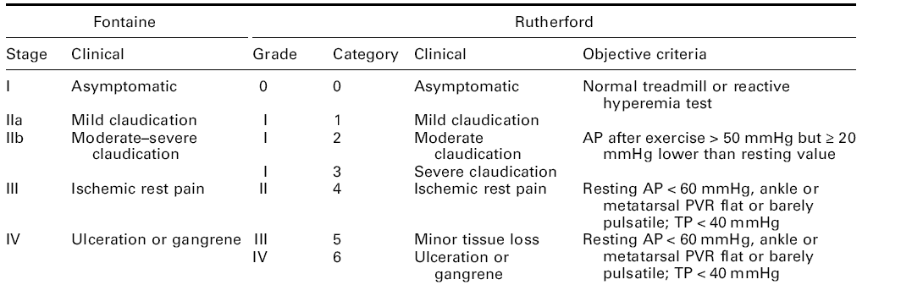
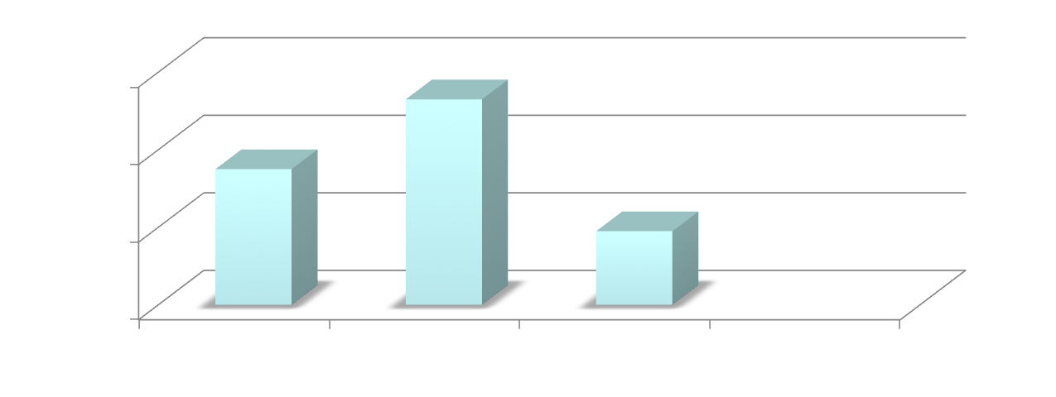
Materials and Methods
35 53 19

Slide 7
Demographics
CAD 73.2% (41/56)
DM 67.9% (38/56)
Chronic Renal Disease 35.7% (20/56)
CAD | DM | Chronic Renal Disease
66% | 73% | 64%
(74/107) | (81/107) | (71/107)

Slide 8
Materials and Methods
Primary endpoints
  technical success of the revascularization procedure
  primary patency
  freedom from major amputation
  survival at follow up
All patients were placed on clopidigrel and aspirin peri-procedurally and continued indefinitely

Slide 9
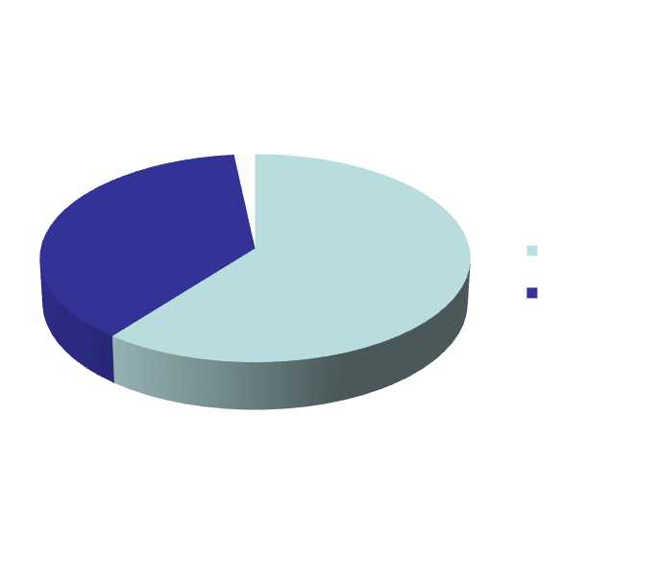
Results
104 patients (66 men, 41 women)
(mean age 82, range 43-93)
  120 angiographic lesions
171 infrapopliteal drug eluting stents
  106 sirolimus, 62 evirolimus, 3 paclitaxel

Slide 10
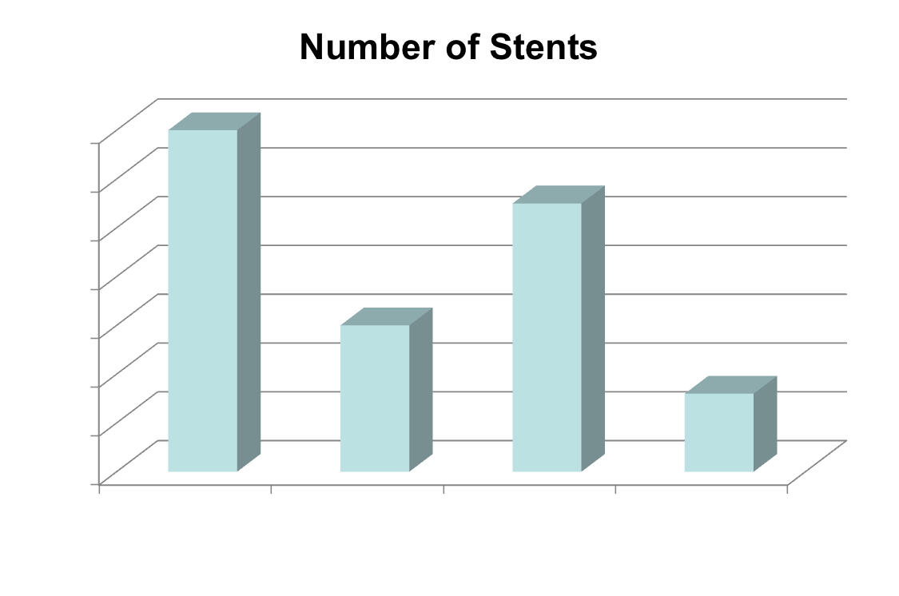
Vessel Distribution
Notes:
Anterior Tibial 44
Posterior Tibial 19
Peroneal 25
TP Trunk 13

Slide 11
Results
Initial technical success rate was 100%
  all treated lesions having less than 10% residual angiographic stenosis
Mean number of stents per patient --- 1.6 (range 1-5)
Stent diameter - 2.5mm to 4mm
Simultaneous femoral-popliteal intervention - 74/107 (69%)
Total occlusions -- 37/107 (35%)

Slide 12
Technical Details
Technical Success | Mean number of stents per patient | Stent Diameter | Simultaneous Fem-Pop Intervention | Total Occlusions
100% | 1.6 (1-5) | 2.5 – 4 mm | 69% (74/107) | 35% (37/107)

Slide 13
Follow-up
Mean follow up was 25 months (1-42 months)
Primary patency at 6 months was 157/171 stents (90%)
Primary patency at 12 months was 129/154 (84%)
Primary patency at 24 months was 86/120 (72%)
Freedom from major amputation was 89.3% (95/107) for the entire cohort
  100% (88/88) for patients with Rutherford 4 and 5 disease (without gangrene)
30 day mortality rate was 1% (1/107)
Overall mortality rate was 22.4% (24/107)

Slide 14
Primary Patency

Slide 15
FREEDOM FROM MAJOR AMPUTATION

Slide 16
Survival

Slide 17
Primary Patency

Slide 18
FREEDOM FROM MAJOR AMPUTATION

Slide 19
Survival

Slide 20
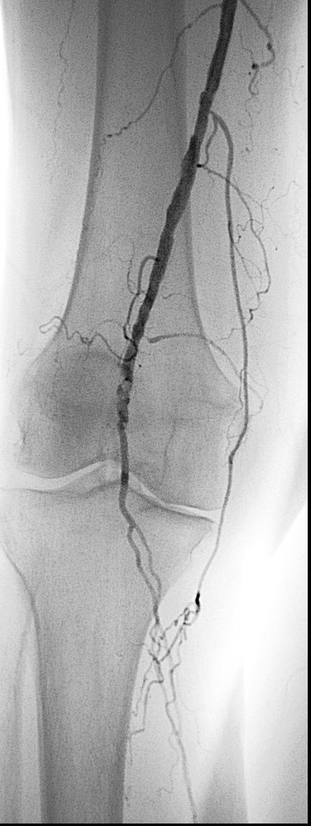
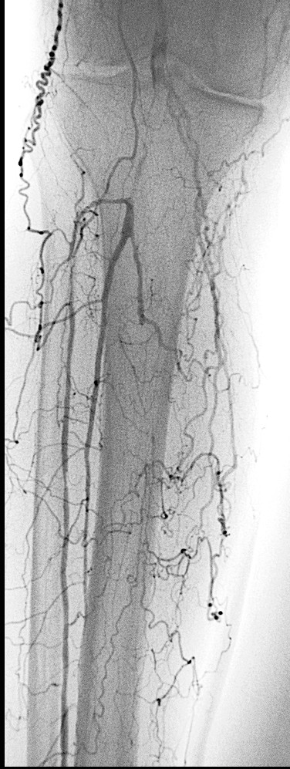
CASE
77 yr old female hypertension, coronary artery disease, renal insufficiency with great toe ulcer

Slide 21
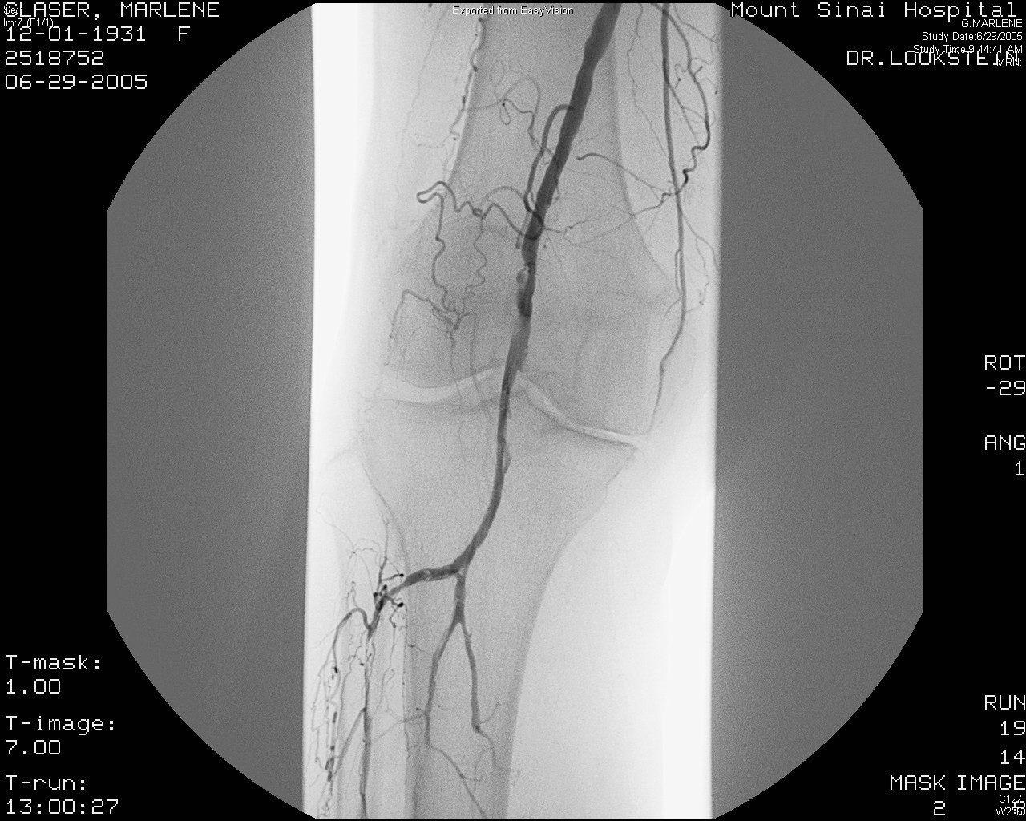
CASE
Following balloon angioplasty of the popliteal and anterior tibial artery

Slide 22
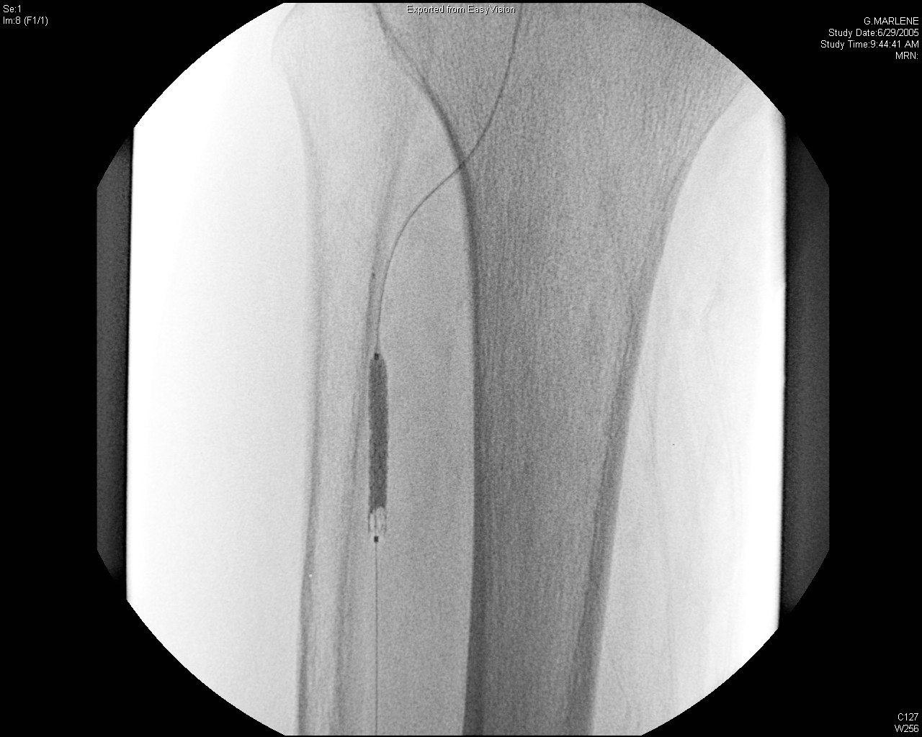
CASE
Following placement of a drug coated stent

Slide 23
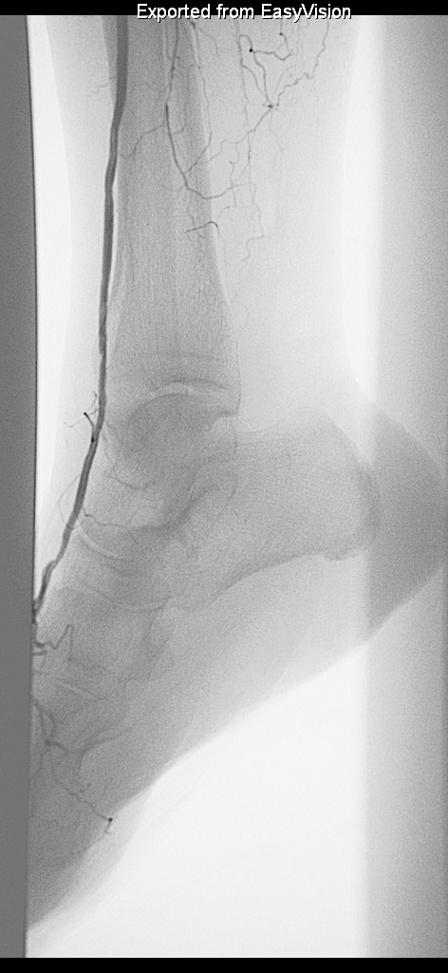
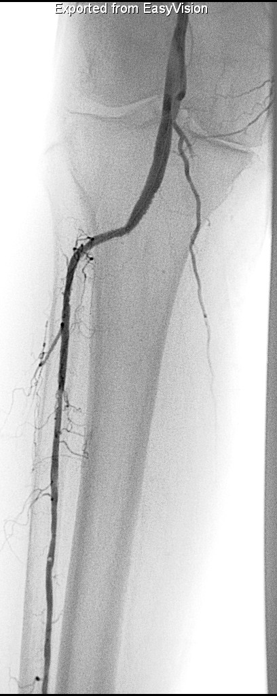

Slide 24
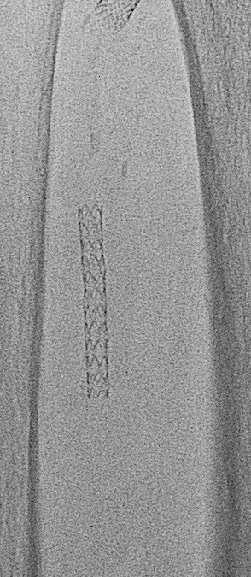
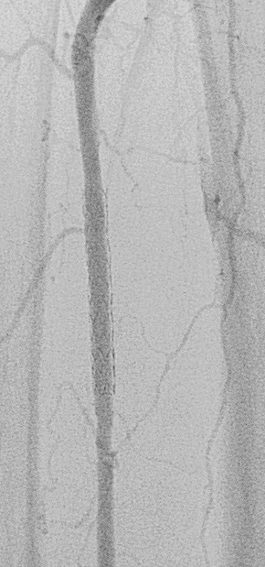
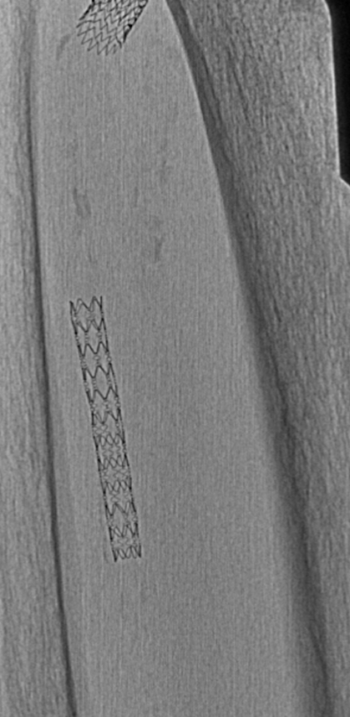
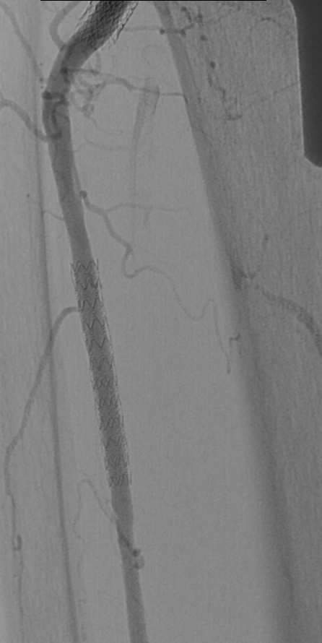
Angiographic Follow Up
18 months 60 months

Slide 25
Conclusions
Placement of below knee drug eluting stents is a safe and effective therapy following failed angioplasty in patients with critical limb ischemia
This procedure has excellent technical success and demonstrates:
  procedural safety
  high primary patency
  Excellent limb salvage rates

Slide 26
Implications
Drug Eluting Stents in the below knee arteries can decrease re-intervention rates and amputation rates in this high risk patient population
Patients should be aware that there are highly successful minimally invasive options performed by Interventional Radiologists available now to relieve their symptoms of critical limb ischemia and help them avoid amputation

